Slide 1
Sugarcane Factory E-Portal

Slide 2
Future Enhancement

Slide 3
Modules
Admin
Farmer
Contractor

Slide 4
Development Tools Details
Tools | Use
Spring tool suite 4 | Back End
React | Front End
MySql | Database
Git | Version control

Slide 5
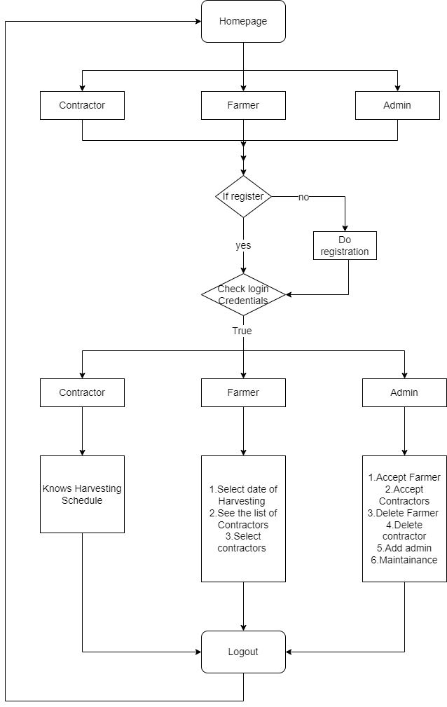
Flow Diagram

Slide 6
Thank You!

